Slide 1
Wine Quality Prediction Using Machine Learning

Slide 2
“Wine Quality Prediction Using ML”
BLDEA’S V P Dr. P G HALAKATTI COLLEGE OF ENGINEERING AND TECHNOLOGY
DEPARTMENT OF COMPUTER SCIENCE AND ENGINEERING
PRESENTATION ON PROJECT PHASE - 2
UNDER THE GUIDANCE OF
Dr. Anand Jumnal
SUBMITTED BY
Kavya Gidaveer(2BL20CS042)

Slide 3
Introduction
The quality of wine is crucial as low-quality wine can negatively affect human health. Consumers are often deceived about the quality of wine in the market, necessitating accurate quality determination.
Traditional methods of assessing wine quality are labor-intensive and subjective. Manual evaluation lacks precision and consistency, leading to unreliable quality labeling.
An automated method to evaluate these attributes can significantly improve the accuracy and efficiency of wine quality assessment. The implementation of machine learning algorithms and ensemble learning methods can automate and enhance the quality prediction process.

Slide 4
Problem Statements
Given the physicochemical properties of wine samples, the goal is to build a predictive model that can accurately determine the quality rating of the wine. The problem can be approached as either a regression task, predicting the exact quality score, or a classification task, categorizing the wine into quality classes (e.g., low, medium, high).
Data Imbalance: Quality ratings may not be evenly distributed, with certain ratings appearing more frequently than others.
Non-linearity: The relationship between physicochemical properties and wine quality may be complex and non-linear.
Feature Correlation: Some features may be highly correlated, which can affect the model's performance.

Slide 5
Objectives
To develop a machine learning model that can accurately predict the quality of wine based on its physicochemical properties. The model will assist winemakers and consumers by providing an automated, reliable assessment of wine quality, thereby aiding in quality control and decision-making processes.
To balance the dataset.
Implement the model in the wine production process to assist in the quality control of wine. By providing objective and consistent quality assessments, the model helps maintain high standards and consistency in wine production.
To optimise the classification models through hyperparameter Tuning and ensemble learning.

Slide 6
Solutions
Data Collection and Preparation:
Dataset
Data Cleaning
Data Splitting
Feature Engineering:
Normalization/Standardization
Feature Selection
Model Deployment:
API Development
User Interface

Slide 7
Features
● Fixed acidity
● Volatile acidity
● Citric acid
● Residual sugar
● Chlorides
● Free sulfur dioxide
● Total sulfur dioxide
● Density
● PH
● Sulphates
● Alcohol

Slide 8
System Architecture
Fig 1: Flow Diagram

Slide 9
Classification Models
Logistic Regression
Logistic Regression is a fundamental statistical technique often used for binary classification problems. The model estimates the probability that a given input belongs to a particular class. It works by applying a logistic function to a linear combination of the input features, resulting in a value between 0 and 1.
In the context of wine quality prediction, Logistic Regression can be used to distinguish between high and low-quality wines based on their chemical attributes. Its simplicity, efficiency, and interpretability make it a popular choice for many classification tasks.

Slide 10
Classification Models
2. XGBoost (XGBClassifier)
XGBoost, short for Extreme Gradient Boosting, is an advanced implementation of gradient boosting that has gained widespread popularity due to its performance and speed.
This iterative process results in a highly accurate predictive model. XGBoost is known for its scalability, ability to handle missing data, and effectiveness in dealing with both classification and regression problems. When applied to wine quality prediction, XGBoost can capture complex patterns in the chemical properties of the wine, leading to precise quality classification.

Slide 11
Classification Models
3. Support Vector Classifier (SVC)
Support Vector Classifier (SVC) is a powerful and versatile machine learning model used for classification tasks. It works by finding the optimal hyperplane that separates the data points of different classes with the maximum margin.
For wine quality prediction, SVC can be used to classify wines into various quality levels by analyzing their chemical characteristics. Its capability to handle nonlinear data through kernel functions makes it suitable for capturing the intricate relationships between the input features and the quality labels.

Slide 12
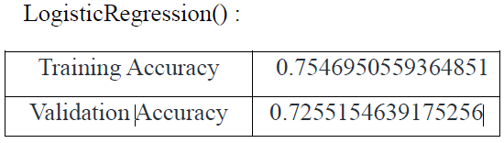
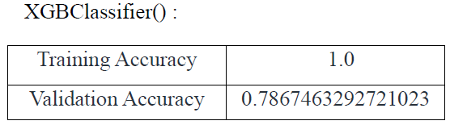
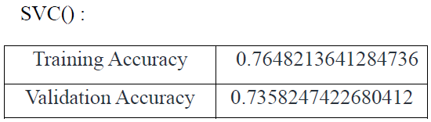
Results
Model Evaluation:
From the below accuracies we can say that Logistic Regression and SVC() classifier performing better on the validation data with less difference between the validation and training data.

Slide 13
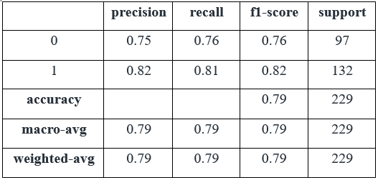
Conti..
Model Performance: The classification report provides an overview of the performance metrics for the model evaluated on the test dataset. The model achieved an overall accuracy of 79%, indicating its ability to correctly classify instances.
Table 1: Classification report for the validation data

Slide 14
Outcomes
Fig 2: shows the histogram, to visualise the distribution of the data with continuous values in the columns of the dataset.
Fig 7.3.1: Histograms for the columns containing continuous data
Fig 2: Histograms for the columns containing continuous data

Slide 15
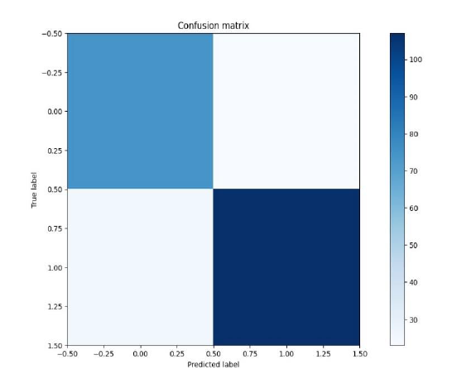
Outcomes
Fig 3: Confusion matrix drawn on the validation data

Slide 16
Conclusion
In this project, we employed advanced machine learning techniques to predict wine quality based on various physicochemical features, achieving an overall accuracy of 79%. We rigorously analyzed a comprehensive dataset and evaluated multiple models, including ensemble methods like Random Forests and Gradient Boosting Machines, to enhance prediction accuracy.
We used metrics like Precision, Recall, F1 score, and support to thoroughly evaluate performance. Our robust framework offers reliable predictions, providing valuable insights for winemakers and enhancing quality control in the wine industry.

Slide 17
References
[1] Swapnil Darade and Nilesh Korade et al. discussed “Wine quality prediction” International Journal of Advances in Engineering and Management (IJAEM) DOI: 10.35629/5252030712461252 Impact Factor value 14.429 | ISO 9001: 2008 Certified Journal Page 13
[2] Muhammad Aslam et al. discussed “Wine Quality Prediction” By Using Machine Learning Algorithms ISSN 2320-9186 13GSJ: Volume 10, Issue 12, December 2022
[3] S. Kumar, K. Agrawal and N. Mandan, "Red Wine Quality Prediction Using Machine Learning Techniques," 2020 International Conference on Computer Communication and Informatics (ICCCI), 2020, pp. 1-6, doi: 10.1109/ICCCI48352.2020.9104095.
[4] Kumar S, Agrawal K, Mandan N. Red wine quality prediction using machine learning Techniques. In 2020 International Conference on Computer Communication and Informatics (ICCCI) 2020 Jan 22 (pp. 1-6). IEEE.

Slide 18
Thank You

